Slide 1


Julie-Ann McCalla
24 April 2024

Slide 2

Outline
Executive Summary
Introduction
Methodology
Results
Conclusion
Appendix

Slide 3
Executive Summary
Summary of methodologies
Data Collection
Data Wrangling
Data Visualization and SQL
Interactive visual analytics using Folium
Predictive analysis using classification models
Summary of all results
Correlations variables
Build a predictive model

Slide 4
Introduction
Project background and context
The commercial space age is here, companies are making space travel affordable for everyone. Virgin Galactic is providing suborbital spaceflights. Rocket Lab is a small satellite provider. Blue Origin manufactures sub-orbital and orbital reusable rockets. Perhaps the most successful is SpaceX. SpaceX's accomplishments include: Sending spacecraft to the International Space Station. Starlink, a satellite internet constellation providing satellite Internet access. Sending manned missions to Space. One reason SpaceX can do this is the rocket launches are relatively inexpensive. SpaceX advertises Falcon 9 rocket launches on its website with a cost of 62 million dollars; other providers cost upwards of 165 million dollars each, much of the savings is because SpaceX can reuse the first stage. Therefore, if we can determine if the first stage will land, we can determine the cost of a launch.
Problems you want to find answers
Use information gathered about Space X to determine the price of each launch.

Slide 5

Section 1

Slide 6
Methodology
Executive Summary
Data collection methodology:
Data was collected using web scraping
Perform data wrangling
Exploratory data analysis to find some patterns in the data and determine what would be the label for training supervised models
Perform exploratory data analysis (EDA) using visualization and SQL
Perform interactive visual analytics using Folium and Plotly Dash
Perform predictive analysis using classification models
Create a machine learning pipeline to predict if the first stage will land given the data from the preceding observation.

Slide 7
Data Collection
Describe how data sets were collected.
Import the relevant libraries
And helper functions
Request and parse the SpaceX Launch data using the GET request
Filter the data within the dataframe to only use Falcon9 launches
import requests
import pandas
import numpy
import datetime
GetBoosterVersion
getLaunchSite
GetPayloadData
getCoreData
we decode the response content as a Json using .json() and turn it into a Pandas dataframe using .json_normalize()
Filter the data dataframe using the BoosterVersion column to only keep the Falcon 9 launches

Slide 8
Data Collection – SpaceX API
GitHub URL:
https://github.com/JulieDataSc/JulieRepos/blob/main/jupyter-labs-spacex-data-collection-api.ipynb
Request the Falcon9 Launch Wiki page from its URL
Decode the response content as a json using and converting it to a pandas dataframe
Construct the dataset using data we obtained
Use previously defined functions to fix information in columns

Slide 9
Data Collection - Scraping
GitHub URL:
https://github.com/JulieDataSc/JulieRepos/blob/main/jupyter-labs-webscraping.ipynb
Request the Falcon9 Launch Wiki page from its URL
Extract column/variable names from the html table header
Parse the launch html tables and store into a dataframe

Slide 10
Data Wrangling
GitHub URL: https://github.com/JulieDataSc/JulieRepos/blob/main/labs-jupyter-spacex-Data%20wrangling.ipynb
Dealing with Missing Values
Calculate the number of launches on each site
Calculate the number of occurrences of each orbit
Calculate the numbers and occurrence of mission outcome of the orbit
Create a landing outcome label from outcome column

Slide 11
EDA with Data Visualization
The following graphs were plotted for this project as they best represents the relationship between the considered variables:
Bar Charts
Scatter Charts
Line Charts
GitHub URL: https://github.com/JulieDataSc/JulieRepos/blob/main/edadataviz.ipynb

Slide 12
EDA with SQL
SQL queries performed:
Display the names of unique launch sites in the space mission
Display 5 records where launch sites begin with the string 'CCA'
Display the total payload mass carried by boosters launched by NASA (CRS)
Display average payload mass carried by booster version F9 v1.1
List the date when the first successful landing outcome in ground pad was achieved.
List the names of the boosters which have success in drone ship and have payload mass greater than 4000 but less than 6000
List the total number of successful and failure mission outcomes
List the names of the booster_versions which have carried the maximum payload mass. Use a subquery
List the records which will display the month names, failure landing_outcomes in drone ship ,booster versions, launch_site for the months in year 2015.
Rank the count of landing outcomes (such as Failure (drone ship) or Success (ground pad)) between the date 2010-06-04 and 2017-03-20, in descending order.
GitHub URL: https://github.com/JulieDataSc/JulieRepos/blob/main/jupyter-labs-spacex-data-collection-api.ipynb

Slide 13
Build an Interactive Map with Folium
Summarize what map objects:
Markers: Shows the geo location using longitude and latitude data
Cluster: This shows a group of markers
Circles: Shows a single location
Lines: Shows the distance between the two points
GitHub URL:
https://github.com/JulieDataSc/JulieRepos/blob/main/lab_jupyter_launch_site_location%20(2).ipynb

Slide 14
Build a Dashboard with Plotly Dash
Summary of plots/graph:
Bar: Shows the difference in categories
Line: Provide reports on time series changes
Pie: Highlights percentages for events
Tree: Shows complex relationships for variables using interactive visualization
Map: Shows variables of states on maps
GitHub URL:
https://github.com/JulieDataSc/JulieRepos/blob/main/spacex_dash_app.py

Slide 15
Predictive Analysis (Classification)
Create variable Y and standardize the variable assigned to X
Split in the train and test database
Calculate: Logistic regression, Support Vector Machine, Decision Tree
Calculate the number and occurrence of mission outcome per orbit type
Compare score accuracies and Select the best model
GitHub URL: https://github.com/JulieDataSc/JulieRepos/blob/main/SpaceX_Machine%20Learning%20Prediction_Part_5.ipynb

Slide 16
Results
Exploratory data analysis results
SpaceX data can be collected using web scraping and API
Interactive analytics demo in screenshots
EDA with SQL is effective for data filtering
EDA with interactive visualization provides insight
Plotty Dash is a powerful to show instant data change
Predictive analysis results
Decision Tree classifier had the best accuracy

Slide 17

Section 2

Slide 18
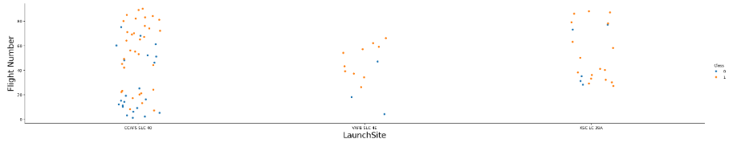
Flight Number vs. Launch Site
Scatter plot of Flight Number vs. Launch Site
CCFS SLC 40 Launch site has the greatest concentration and flight numbers.

Slide 19
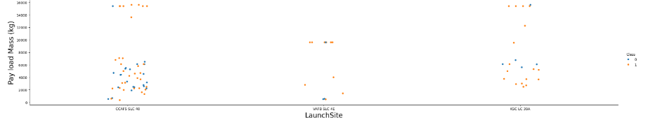
Payload vs. Launch Site
Scatter plot of Payload vs. Launch Site
The correlation between payload and launch site is relatively moderate.

Slide 20
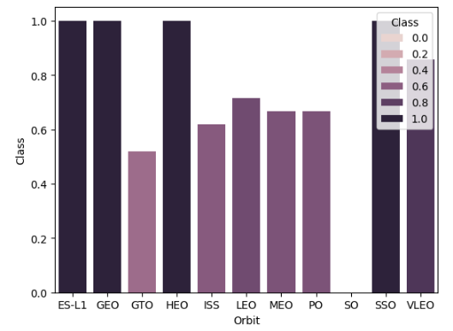
Success Rate vs. Orbit Type
Bar chart for the success rate of each orbit type

Slide 21
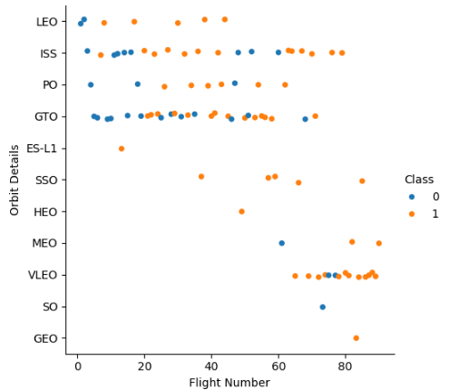
Flight Number vs. Orbit Type
Scatter point of Flight number vs. Orbit type
VLEO has a high flight numbers for all its orbit showing a strong relationship, whilst could be seen as moderately or evenly distributed.

Slide 22
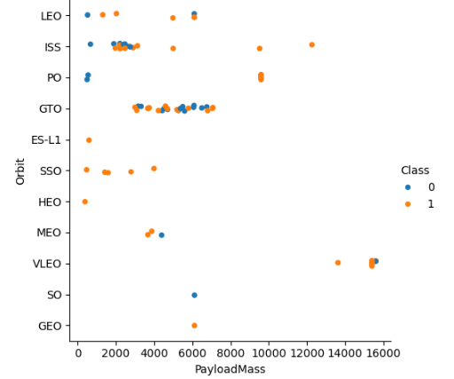
Payload vs. Orbit Type
Scatter point of payload vs. orbit type
For VLEO payload negatively impacts the orbit.

Slide 23
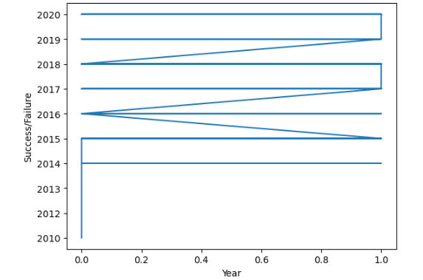
Launch Success Yearly Trend
Show a line chart of yearly average success rate
Show the screenshot of the scatter plot with explanations

Slide 24
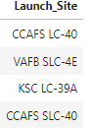
All Launch Site Names
The names of the unique launch sites present in the database

Slide 25
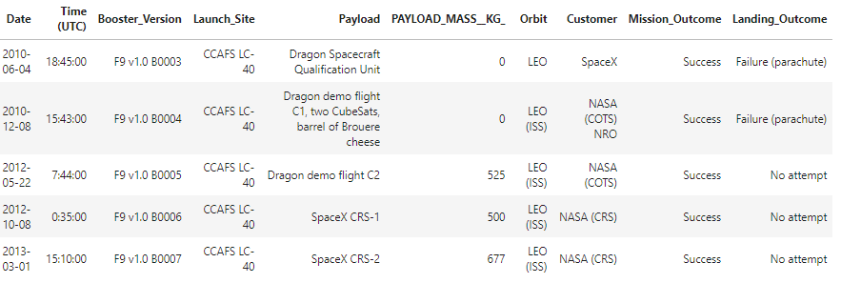
Launch Site Names Begin with 'CCA'
Displaying five(5) records where launch sites begin with `CCA`

Slide 26
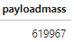
Total Payload Mass
Payload carried by boosters from NASA

Slide 27
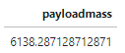
Average Payload Mass by F9 v1.1
Average payload mass carried by booster version F9 v1.1

Slide 28
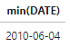
First Successful Ground Landing Date
Date of the first successful landing outcome on ground pad

Slide 29
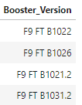
Successful Drone Ship Landing with Payload between 4000 and 6000
Names of boosters which have successfully landed on drone ship and had payload mass greater than 4000 but less than 6000

Slide 30
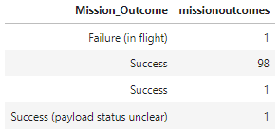
Total Number of Successful and Failure Mission Outcomes
Total number of successful and failure mission outcomes

Slide 31
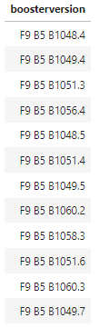
Boosters Carried Maximum Payload
Names of the booster which have carried the maximum payload mass

Slide 32
2015 Launch Records
Failed landing_outcomes in drone ship, their booster versions, and launch site names for in year 2015

Slide 33
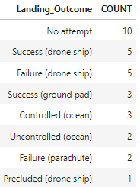
Rank Landing Outcomes Between 2010-06-04 and 2017-03-20
The rank by count of landing outcomes (such as Failure (drone ship) or Success (ground pad)) between the date 2010-06-04 and 2017-03-20, in descending order

Slide 34

Section 3

Slide 35
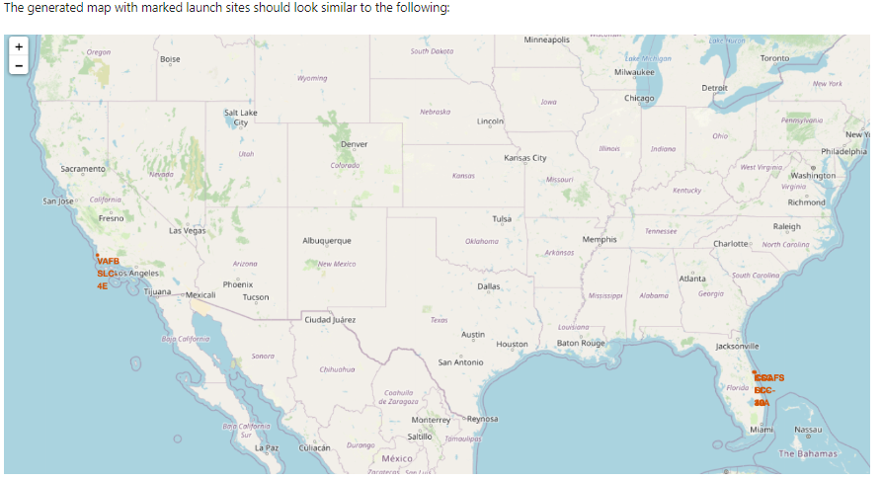
Launch Sites
Both sites at ground and sea surface are necessary.

Slide 36
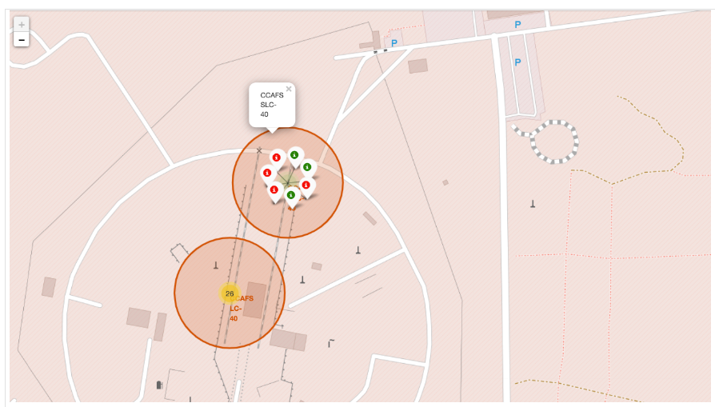
Success of launch
Adding colour elements is an impressive way of displaying successful launch

Slide 37
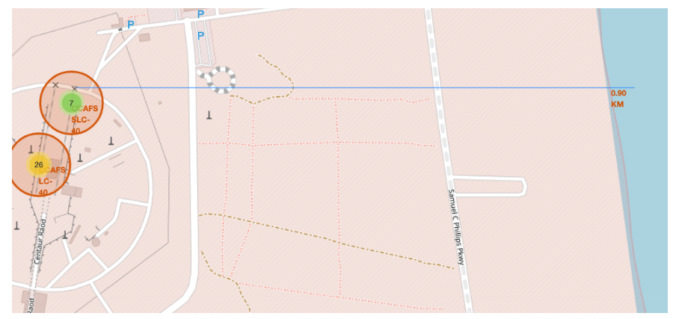
Distance
The plot of distance between locations allows for estimation of travel time. And decision making.

Slide 38

Section 4

Slide 39
The Most Successful Launch Site
Replace <Dashboard screenshot 1> title with an appropriate title
Show the screenshot of launch success count for all sites, in a piechart
Explain the important elements and findings on the screenshot

Slide 40
Payload and Successful launch
Replace <Dashboard screenshot 2> title with an appropriate title
Show the screenshot of the piechart for the launch site with highest launch success ratio
Explain the important elements and findings on the screenshot

Slide 41
<Dashboard Screenshot 3>
Replace <Dashboard screenshot 3> title with an appropriate title
Show screenshots of Payload vs. Launch Outcome scatter plot for all sites, with different payload selected in the range slider
Explain the important elements and findings on the screenshot, such as which payload range or booster version have the largest success rate, etc.

Slide 42

Section 5

Slide 43
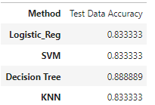
Classification Accuracy
The model accuracy for Decision Tree is the best whilst the other classification models are the same.

Slide 44
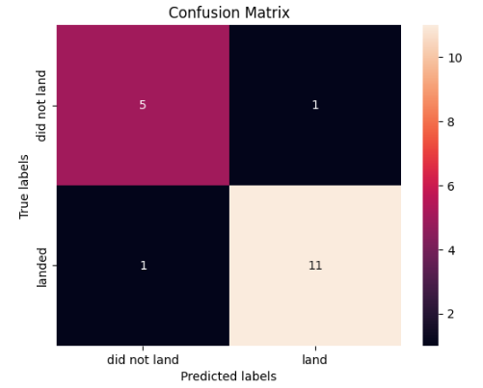
Confusion Matrix
The confusion matrix of the best performing model is the Decision Tree. It shows a 88% accuracy for predictions.

Slide 45
Conclusions
Modeling can provide insight for data through visualization and aide in the decision making process
The success rate for SpaceX launches has been increasing moderately and with time and correct payload the required target will be met
Using a Decision tree model classifier for this dataset is the best.

Slide 46
Appendix
Include any relevant assets like Python code snippets, SQL queries, charts, Notebook outputs, or data sets that you may have created during this project

Slide 47


